Slide 1
Q3 2018 Town Hall
Notes:
Welcome to the CCHS Q3 Town Hall.
Next Slide – Agenda

Slide 2
Agenda
Welcome & Agenda Overview
Q3 2018 Service Milestones & Promotions
Business Update
Financial Overview
Communication & Employee Engagement
2018 Enterprise Priorities Update
Boca Move Update
Q&A
Notes:
Today we will be covering (talk through agenda).
Next Slide – Service Milestones Intro Slide

Slide 3
Q3 Service Milestones and Promotions
Notes:
As always, we want to start by recognizing those of you that have met key milestones in your time with the company. We appreciate your long term commitment and dedication.
Next Slide – 20-year Service Milestone

Slide 4
Promotions/Career Progression (Q3 2018)
Dwight Bozeman, Customer Service Associate to Case Management Specialist
Diego Chavez, QA Analyst to Senior QA Analyst
Tai Fowler, Customer Service Associate to Case Management Specialist
Amanda Freeman, HMS Enrollment Representative to Accounts Receivable Specialist
Brandon Galloway, Authorizations Help Desk Agent to Authorizations Supervisor
Gita Gobaya, IT Business Analyst to Service Readiness Manager
Alicia Harmon, SNAD Net Enhancement Associate to Support Services Associate II
Tory A. Isaac, Regional Manager to Account Manager (Point of Need)
Frantzia Jean-Pierre, Purchasing Clerk to Technical Support Specialist
Congratulations!
Notes:
(Note, there are two slides of promotions)
I also want to take a moment to recognize all those who have been promoted or have had career progression within the organization in Q3 of 2018. One of this year’s EPs is to ensure our associates have opportunities for career growth at CCHS, which I’ll talk more about that later in this presentation…
Congratulations!
Next Slide – Promotions in Q3 continues . . .

Slide 5
Promotions/Career Progression (Q3 2018)
Joy Jenkins, Customer Retention Specialist to Quality Assurance Specialist
Amy Mallory, Claim Intake Specialist to HMS Customer Service Supervisor
Chrystal D. Smith, QA Specialist to Client Services Supervisor
Angela Riccardi, QA Specialist to Service Management Supervisor
Malcolm Ricks, Authorizations Research Agent I to High Priority Claims Agent
Billy Smith, Authorizer to Case Management Specialist
Gordon Smith, Authorizations Specialist to Authorizations Supervisor
Diana Zamora, Manager to Senior Manager (Accounting & Finance)
Congratulations!
Notes:
Next Slide – Business Update

Slide 6
Business Update
Proposed Lobby Rendering
Notes:
Next Slide – CCHS Today

Slide 7





CCHS Today
Disruptive Change
Analog to Digital
Well positioned
Award winning
Tremendous Growth
in our industry
in our industry and the business community
4-year CAGR is 20+ percent
Notes:
I want to start by reminding everyone how far we have come in the past few years, thanks to your efforts.
We are well-positioned with regard to our competition
We are being recognized within our industry and our community, We continue to be eligible and apply for recognitions like Top 100 Private Companies, SFBJ Fast 5O, the Inc. 5000 and others that highlight our growth.
We have taken steps to be an HPC and BPTW through the launch of new benefits, our new building, the talent management program, redevelopment of our core values and more
We have moved from analog to digital with ServiceBench, SMS Technology, IVR Technology, the first Alexa, Buoy/SmartHomes…
We have a rare 4-year CAGR of 20+ percent
We have had some challenges this year, but that shouldn’t completely overshadow our achievements.
Next Slide – Service Delivery Critical Milestones

Slide 8

Service Delivery – Notable Achievements
Cycle Time
Improved 3.4 days since June
Phone Service Levels
On Target: May-Aug 70%
NowAnalytics
80% of customers saw no change or some improvement
20% were heavily impacted
Exceptions
Compressed by 37%
Notes:
Service Delivery remains critical in achieving both our short and long term goals
CT, SL and Exceptions – all improving
Our joint business process assessment has already uncovered a number of gaps. Data received to date has shown that approximately 80% of our customers saw no change to their customer service delivery (and in most cases, some improvement) from the implementation of our new technology platform last fall. While complicated claims or those with exceptions, estimated at approximately 20 percent, experienced substantial process flaws. For this 20 percent of our customer base, cycle time actually doubled. We are also seeing 66% improvement in our outlier claims exceptions in the last 90 days and we expect further improvement.
Next Slide – MyAccount 4.0 is Live

Slide 9

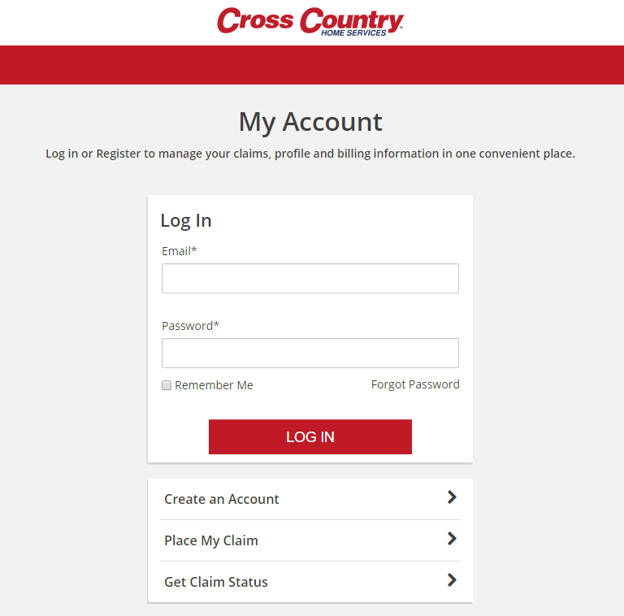
MyAccount 4.0 is Live
Customer Expansion
New Phase II Product Changes
Added Appliance Buyline
Service Request Cancellations
(California) Contract Cancellations
Customized Appointment Messages & Confirmation
Notes:
I am also pleased to share that MyAccount 4.0 is Live. This new version provides our customers with even more digital forward capabilities, which is critical to improved customer service and to growing our business. Upgrades include:
Customer Expansion – Appliance Protect, Plumbing Protect, Systems Protect, Systems MD and Systems MD Gold customers may now use HomeCentric’s MyAccount site; and TXU customers may now access MyAccount, as well.
New Phase II Product Changes – T’s & C’s and essential product info are now accessible for DTC, Financial Channel and HMS customers who renew into PII products.
Added Appliance Buyline – Excluding those with Sears, users can now navigate to the Appliance Buyline option, which provides savings for name brand appliances, and learn how to use the feature.
Service Request Cancellations – (as shown in the figure [right]) users may now cancel a Service Request. An email notification will be sent to the customer, and a notification will be sent to the Service Provider via ServiceBench.
(California) Contract Cancellations – a new workflow allows CA users to cancel their contract. If applicable, refunds or payments will be viewable within the account, and on-screen/email confirmations will be provided.
Customized Appointment Messages & Confirmation – to further improve the customer experience, our communications during the Service Request process have been enhanced. A message will now alert customers their appointments are not guaranteed until the customer contacts the assigned Service Partner for confirmation. This applies to appointments assigned to all Service Partners, except for Sears.
And there is still more to come! The team will be working on re-designing and re-branding MyAccount, to ensure we are ready for the Brand launch.
Next Slide – Financial Overview

Slide 10
Financial Overview
Proposed Lobby Rendering
Notes:
Next Slide – Reveue

Slide 11
2018 Enterprise Priorities
Notes:
Now, I want to spend a bulk of our time this afternoon focusing on our 2018 Enterprise Priorities, as they are critical to our operational and financial success for the year.
Next Slide – Strategic Pillars and EPs (House)

Slide 12

2018 Strategic Pillars & Enterprises Priorities
Strategic Pillars
Enterprises Priorities
Execute Corporate Re-Brand and Unification
Create Pricing Flexibility for Warranty Products
Implement Messaging & Response (JSN)
Develop and Initiate Multi-Year Enterprise Technology Roadmap
Revise and Align Core Values and Brand Attributes
Deploy New Talent Management Program
Enter and Launch Insurance Vertical
Comprehensive Point Of Need (PON) Market Entry
Customer
Service
Excellence
Service
Network
Supremacy
Product & Channel Innovation
Expanded
Affinity
Distribution
High Performance Culture
Notes:
Give high level overview/Intro.
Next Slide – Execute Corporate Re-Brand and Unification

Slide 13
Communication & Employee Engagement
Notes:
Next Slide – Status/Next Steps on Employee Engagement

Slide 14







Ways We Communicate
CEO Messaging &
Roundtables
Surveys
1-on-1 Communication
(Coaching, Peer-to-Peer, Supervisor)
Cinch/Associate
Newsletter
ELT/Department/
Cross-functional
Meetings
Town Halls
Weekly Wrap-Up E-mail
Action Required From You !
Notes:
1:1 Communication is the core of how we communicate. We also have a lot of other communication tools that you should be looking out for. For example we have our Cinch Check In newsletter which will soon be transitioning to a company/associate-wide newsletter, our Weekly Wrap Ups every Friday with business highlights from the week, e-mail messages from myself and our other Executive Leaders, as well as cross functional and Expended Leadership Meetings and Surveys…
Next Slide: New Boca Raton Facility Intro Slide

Slide 15

Communication Framework
Ops Target: 10 days
CEO
Exec Team
Non Ops Target: 5 days
Operations
Non Operations
VP /
Directors
SVP, VP, Sr. Dir., Dir.
Mgrs.
Managers
Supv
Individual Contributors
2-Way Communication & Feedback Loop
Agents
Notes:
This is our new communication loop to ensure that messaging is being carried through the org. It starts with CEO Communication (Town Hall, ELT, eMail Messaging) and follows through every level of the org. Reporting of the communication process goes back up to the Executive Team to ensure delivery and clarity of all messaging.
Next Slide – How We Communicate Today

Slide 16
New Boca Facility
Proposed Lobby Rendering
Proposed Lobby Rendering
Notes:
Next Slide – Phase 1 & 2 Move Dates

Slide 17
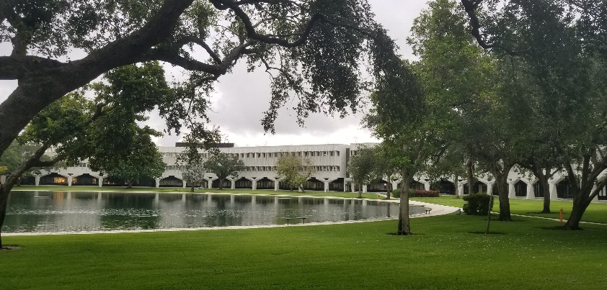
Facility Highlights
Centrally located in beautiful Boca Raton, easy access to I-95 and Florida’s Turnpike, Tri-Rail bus station located on campus with direct buses to property
Office Building
Café and Starbucks
Open concept Wi-Fi Oasis Café with floor-to-ceiling windows and water views
Huddle rooms featuring raised bar high seating and tables with white board finishes
Electronic meeting room booking system
Wellness quiet room with cooling station (fridge)
Other amenities like dry cleaning, and car wash
On Campus
State-of-the-art Fitness Center
On-campus licensed Day Care
Retail, restaurant and banking facility
Notes:
Next Slide: Phase 1 & 2 Move Dates

Slide 18


Phase 1 & 2 Move Dates
PHASE 1
DAY 1
in Boca Raton
Executive Team
Legal
Marketing & Product
Business Development
HR
PHASE 2
DAY 1
in Boca Raton
Finance
Operations *
Facilities
IT
Those remaining in Building B will move to Building E on Nov. 9.
* Contact Center Operations will remain in Sunrise through Fall 2019
Notes:
You should have received an email about the move yesterday, explaining Phase 1 and 2 and that the Contact Center will remain in Sunrise until Fall 2019. We have now assigned Move Coordinators in each department to help facilitate a smooth transition. I know there are questions, but please be patient - more detailed communication will be coming out this week to the groups that are moving.
Next Slide: Q&A

Slide 19

Q & A – We Welcome Your Questions
Text:
(954) 314-1237
Notes:
Next Slide – Closing Remarks

Slide 20
Closing Remarks
Notes:
END

